Slide 1
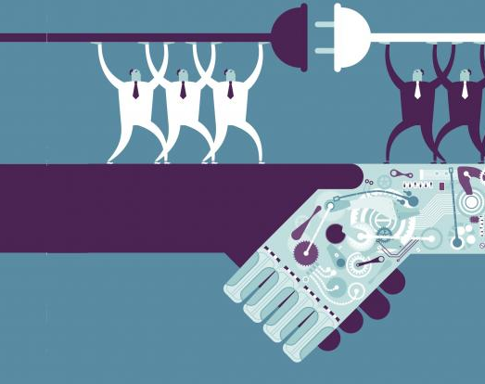
SIDBI- Small Industries Development Bank Of India

Slide 2
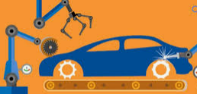



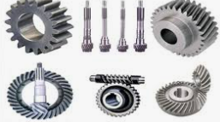
Industry Concentration
Automobile Industry
Textile Industry
Leather Industry
General Engineering
Electrical Components
Solar Panels

Slide 3
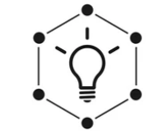

Key Initiatives
Digital Transformation – Online Loan Application & Documentation
Focus on 4C- Customer, Commitment, Competitive & Clarity
Launching of New Scheme like 4E, ARISE, STHAPAN
Encouraging Entrepreneurship culture among youth such as Udyam Gyanshala, Swavlamban Mela, Swavlamban Clubs

Slide 4
ARISE Assistance to Re-Energize Capital Investment by SMEs
Brownfield Units
Two Models
100% financing with cash collateral based model.
75-80% financing with 20-25% promoter contribution
Attractive ROI Repo linked.
Quicker Sanction
TL up to Rs 500 lakh under 100% financing model/1000 lakh with maximum repayment period of 7 years
Minimum two year full operations and cash profit in last FY

Slide 5
STHAPAN SIDBI Thematic Assistance for purchase of capital assets in new enterprises
Greenfield Projects with promoters having 5 years experience
Land, Building, Machine & MFA
Attractive ROI Repo linked.
Target Sectors under PLI Scheme
Maximum TL of 20 Crore with 25% minimum PC
Repayment period- 7years with moratorium up to 2 years

Slide 6
4E Scheme End to End Energy Efficiency Investment in SMEs
Promote energy efficiency, reduce CHG, climate change mitigation
Target Sector-Manufacturing, EE technology & Renewable Energy
Models:
100% machine financing with cash collateral
Attractive ROI linked to Repo Rate
Repayment period – 5 years with moratorium up to 6 months

Slide 7
SAPHAL-SIDBI ASSISTANCE TO PURCHASE HSIIDC ALLOTTED INDUSTRIAL PLOTS FOR MSMEs
Two Stage financing for purchase of plots in METL/HSIIDC
Financing for HSIIDC plots at IMT Faridabad, Kundli, Rai, Sohna
Existing Units in operation for 5 years with last 3 years net profit.
Maximum TL of Rs 600 lakh with 25% minimum PC
Maximum Exposure for both stages of financing together is Rs 15 Crore
Repayment period of 4 years with moratorium of up to 6 months
Second Phase to be initiated within 18-24 months from first disbursement
Attractive ROI MCLR linked.

Slide 8
Thank You

